Slide 1
Self driving car
Presented by:
Bassel Khaled Abdelhaleem
Malak Khaled Ibrahim

Slide 2
Introduction
Brief explanation

Slide 3
Introduction
We chose this project as a team because after finishing the interfacing sessions we wanted to implement something challenging where we can apply what we studied plus implement hardware connections.
The self driving car is a car that moves forward in an idle state when an obstacle is detected based on a specific distance measured using the ultrasonic sensor, the car stops.
When the car stops the servo motor then must rotate left and right for the ultrasonic sensor to measure which direction to go to, the wheels then rotate in this direction.

Slide 4
Components used
Discussing the components used in this project

Slide 5
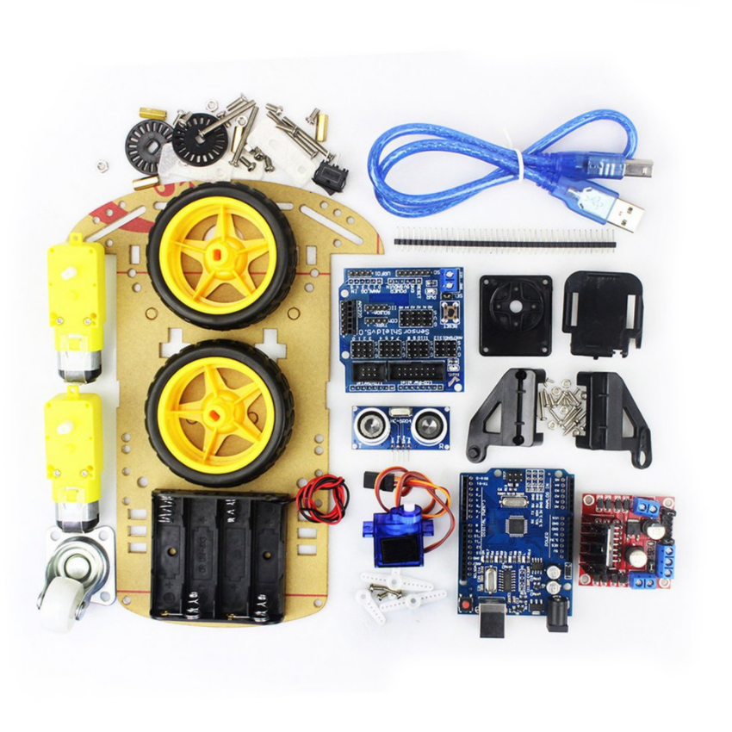

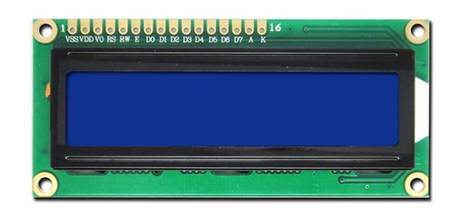
Components
Car kit
Amit learning kit
1x car kit
1x Servo motor
1x ultrasonic sensor
1x lcd (2*16)
2x dc motor
DC motor
Ultrasonic
Servo
LCD (2*16)

Slide 6
Modules used
Discussing the different parts of the code

Slide 7
Modules used
We wanted to implement our code using modular programming to make implementation easier.
We divided the code into 3 main folders
APP (app layer so user can immediately implement specific functions)
Main
Hal (to write functions of external peripherals ie. Servo motor , lcd … etc)
LCD
Servo
Ultrasonic
Dc motor
Mcal (to write functions for internal peripherals of microcontroller ie. Dio , timers … etc)
Dio
Timers
Registers
Interrupt
Also additional files like std_types and macros

Slide 8
Project challenges
Discussing the challenges faced during implementation

Slide 9
Project challenges
LCD
DC motor
Servo Motor
Ultrasonic
Due to using the AMIT learning kit we had to configure the lcd to work on 4-bit mode (sending data on 2 rounds).
Also to optimize pin usage.
The dc motor failed to work with the H-bridge module.
We tried several implementations and codes on simulation till we concluded that we should connect the motors on ground and pin that produces the PWM (to control speed).
However, it still doesn’t work on the hardware components we have as the motors are old and need higher power to push the car forward.
At first, we used the servo motor on timer 1 to use the input capture unit to produce the PWM.
However, the ultrasonic also needed the same capture unit and it was hard to implement both components on the same interrupt.
Therefore, we controlled the servo motor using system delay were delay 0.5 interpreted by the servo to 0 degrees , delay 1.5 to 90 degree and delay 2.5 to 180 degree.
The interfacing of this module was quite challenging as we did not cover something similar during the sessions.
We had to send a signal and then wait for the signal to return to calculate the time taken which helps us calculate the distance of the objects.

Slide 10
Conclusion
Concluding project

Slide 11
Conclusion
We did learn a lot during the implementation of this project. Also faced a lot of challenges which helped us learn more about how different modules work and interact together.
This project helped us use different techniques like :
Using simulation to check for problems
Using some sort of debugging to check for errors in code

Slide 12
Thank You

